Slide 1


Workflow of resting state connectivity from a raw dataset to longitudinal visualization
Kevin Jamey - PSY 6983

Slide 2
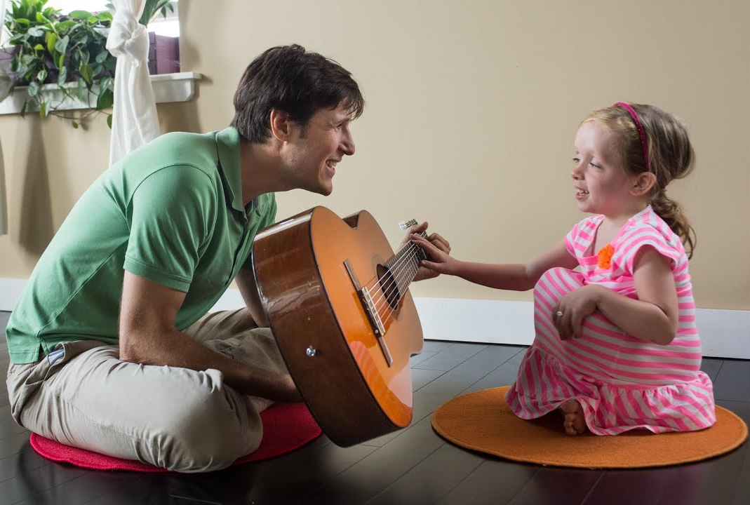
Main Objectives
To provide a full neuroimaging workflow from preprocessing of raw data to visualisation of results
To explore longitudinal comparisons between two time points in this dataset
To analyse resting-state networks linked to joint attention (dorsal attention + DMN)

Slide 3
Personal objectives
To learn the full workflow of neuroimaging from converting raw data to preprocessing to data visualisation
To set myself up with open science tools for neuroimaging work in the future
To get familiar with the best practices of shareable open science kits and software

Slide 4
Skills/tools
Git and Github for sharing project
dcm2bids for converting raw data into NiFTY and a BIDS structure
fMRIPrep for data preprocessing
Alliance Canada for computing pre-processing
Python Packages matplotlib, nilearn, plotly

Slide 5
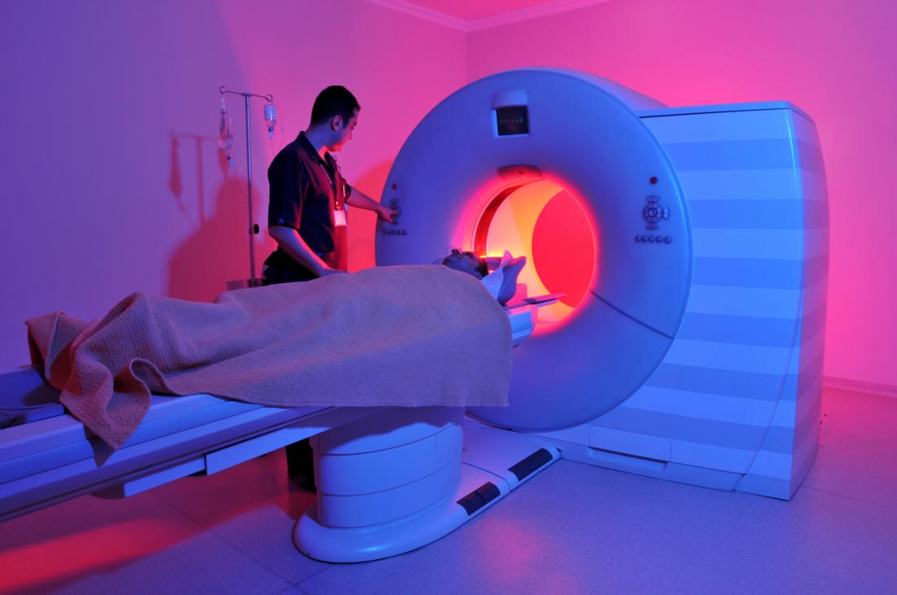
Data/Resources
Dataset I collected during my masters in 2016 at the MNI
~50 participants pre-post (~100 scans)
resting-state fMRI (10 minutes)
T1 structural scans

Slide 6
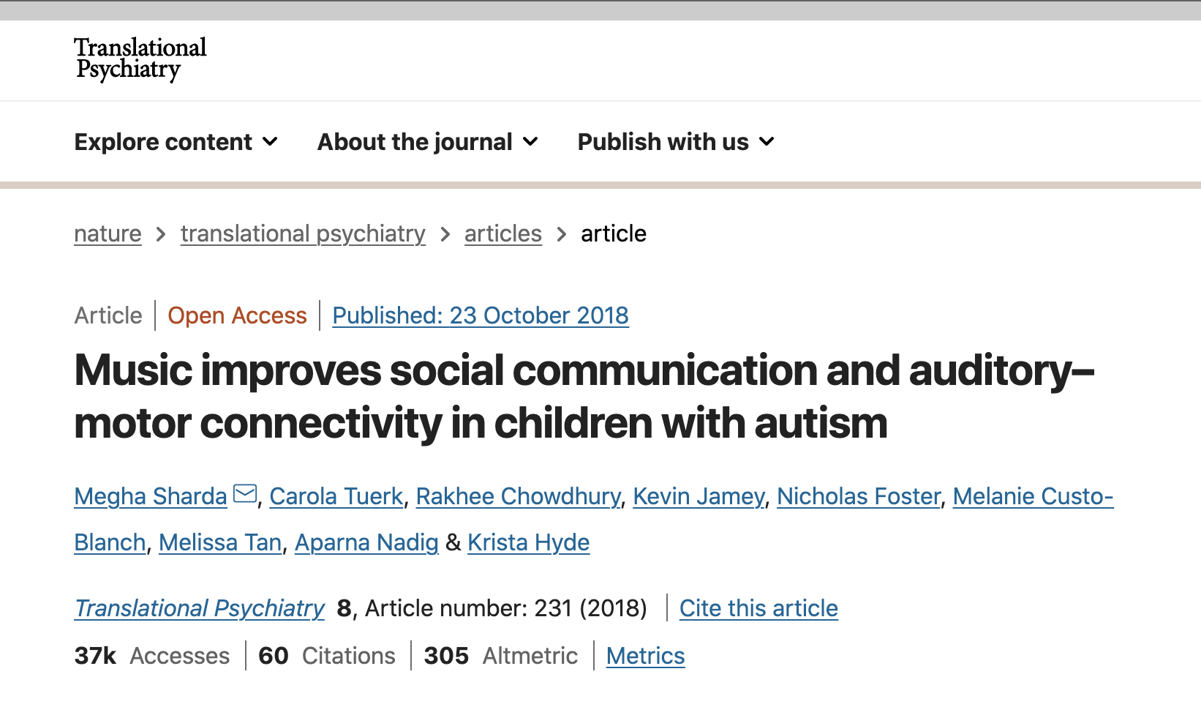
Specific objectives
Pre-post group comparison between 2 activities (music therapy vs. arts & crafts) on functional connectivity
Previous publication using this dataset - data is usable
I want explore other networks (DMN, dorsal attention)
https://www.nature.com/articles/s41398-018-0287-3

Slide 7
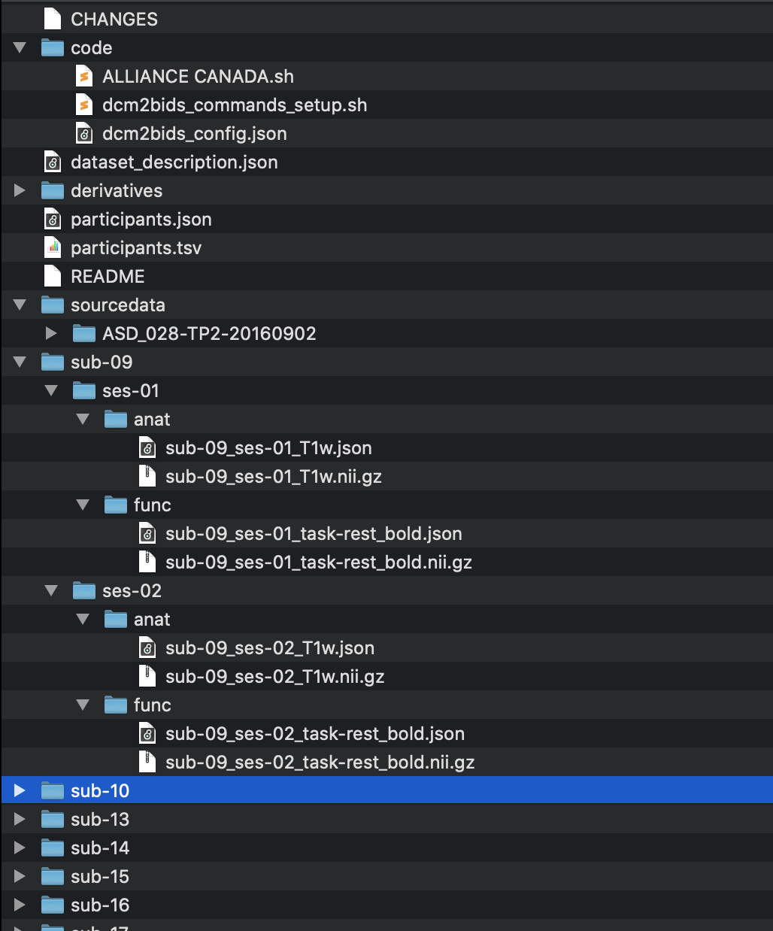
Phase 1:
Converting raw data
Converted a batch of 10 participants in dataset to NiFTY and BIDS format using dcm2bids in terminal

Slide 8
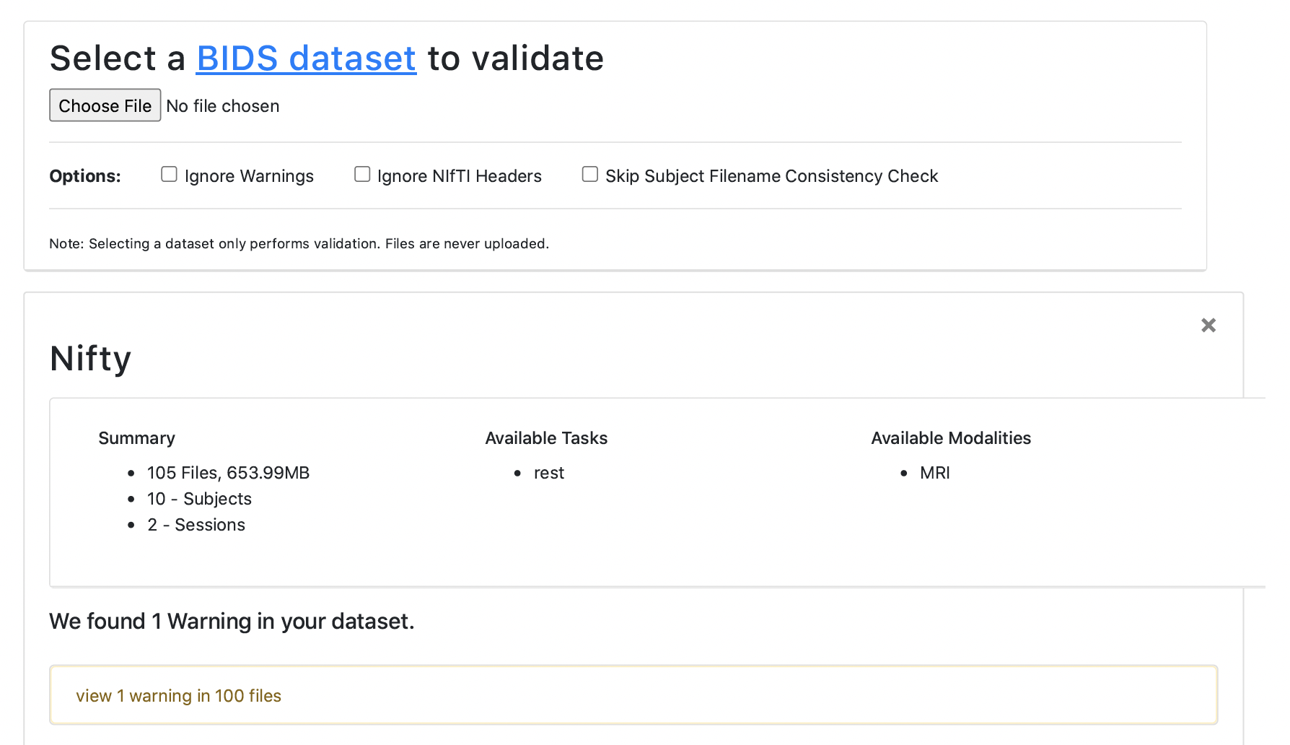
Phase 1:
Converting raw data
Verified with BIDS validator

Slide 9
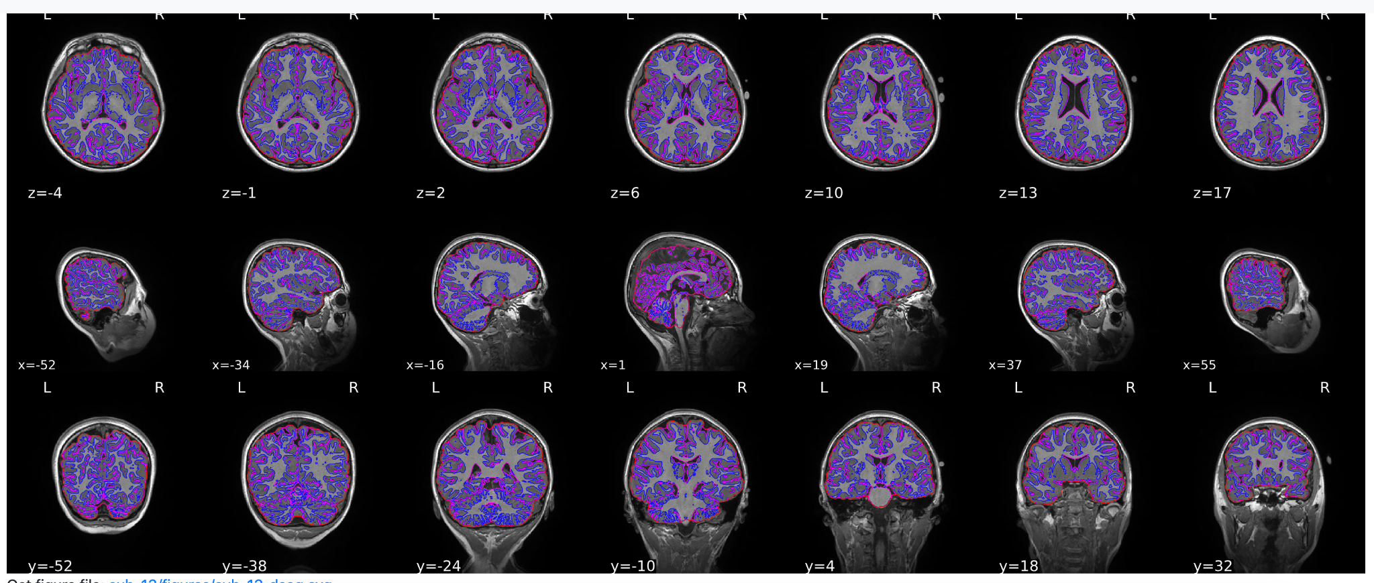
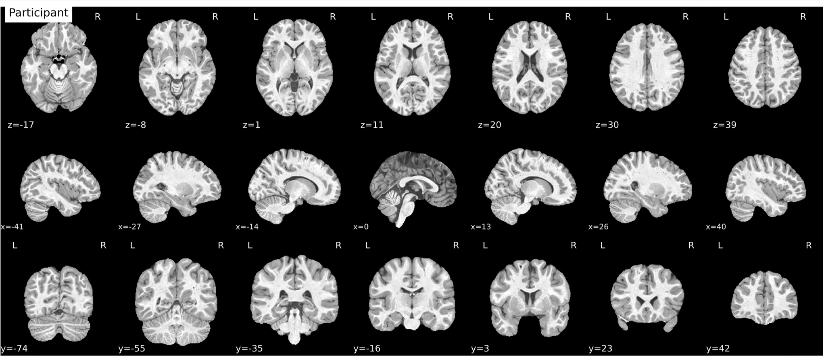
Phase 2: Image processing
Used fMRIprep to convert the BIDS data batch
Issues with Alliance Canada
Brain mask and brain tissue segmentation of the T1w
Spatial normalization of the anatomical T1w reference
Surface reconstruction
Aligns functional data to anatomical data
Brain mask of confounding components

Slide 10
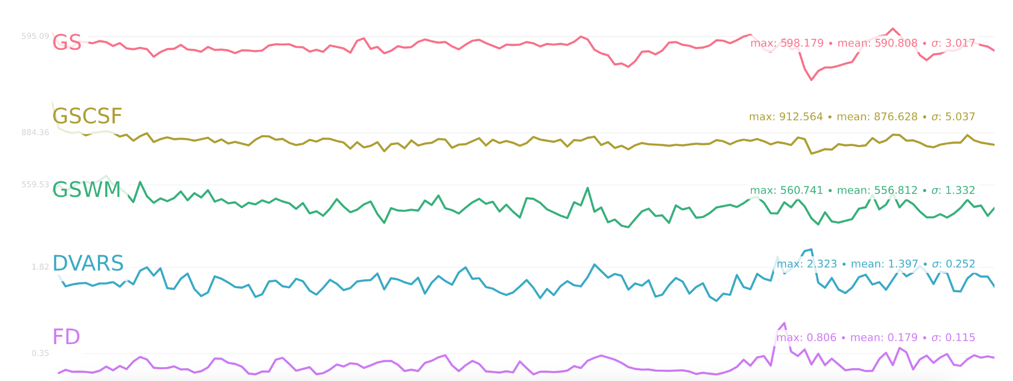
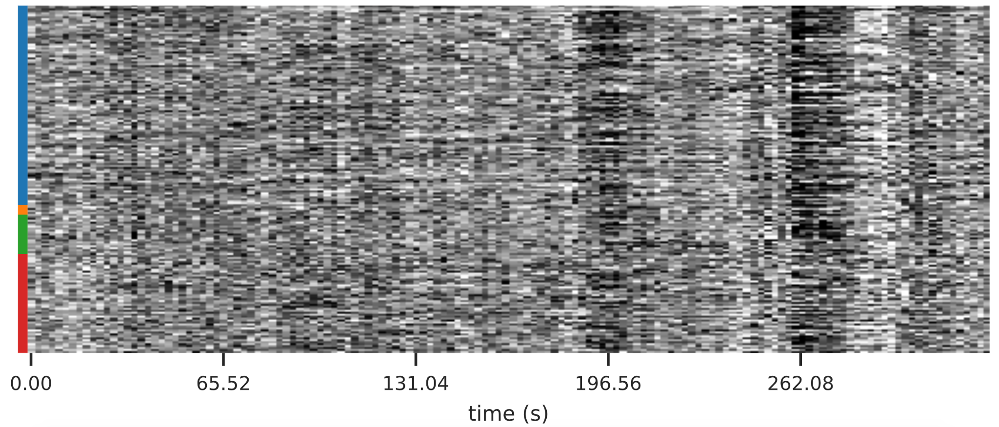
Phase 2: Image processing
Summary stats

Slide 11
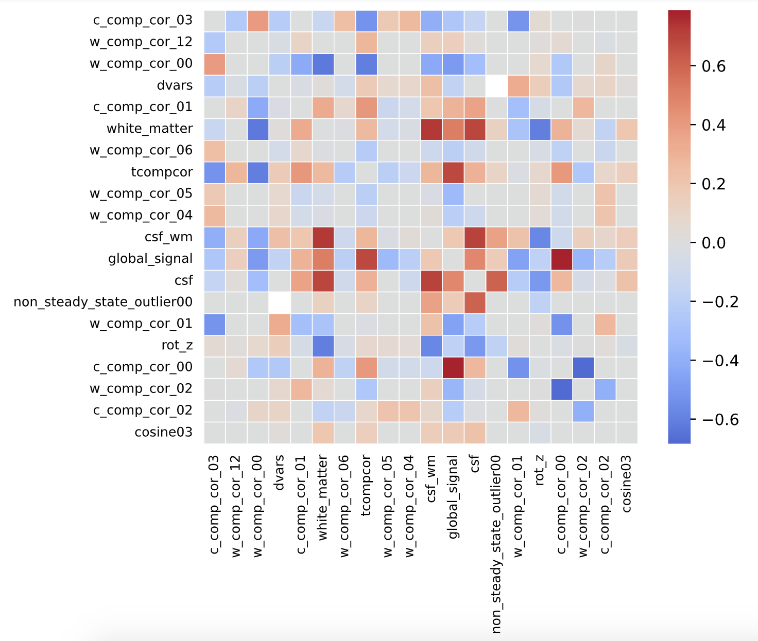
Phase 2: Image processing
Correlations amongst nuisance regressors

Slide 12
Phase 2: Image processing
Methods sections
Results included in this manuscript come from preprocessing performed using fMRIPrep 21.0.2 (Esteban, Markiewicz, et al. (2018); Esteban, Blair, et al. (2018); RRID:SCR_016216), which is based on Nipype 1.6.1 (K. Gorgolewski et al. (2011); K. J. Gorgolewski et al. (2018); RRID:SCR_002502).
Anatomical data preprocessing
A total of 2 T1-weighted (T1w) images were found within the input BIDS dataset. All of them were corrected for intensity non-uniformity (INU) with N4BiasFieldCorrection (Tustison et al. 2010), distributed with ANTs 2.3.3 (Avants et al. 2008, RRID:SCR_004757). The T1w-reference was then skull-stripped with a Nipype implementation of the antsBrainExtraction.sh workflow (from ANTs), using OASIS30ANTs as target template. Brain tissue segmentation of cerebrospinal fluid (CSF), white-matter (WM) and gray-matter (GM) was performed on the brain-extracted T1w using fast (FSL 6.0.5.1:57b01774, RRID:SCR_002823, Zhang, Brady, and Smith 2001). A T1w-reference map was computed after registration of 2 T1w images (after INU-correction) using mri_robust_template (FreeSurfer 6.0.1, Reuter, Rosas, and Fischl 2010). Brain surfaces were reconstructed using recon-all (FreeSurfer 6.0.1, RRID:SCR_001847, Dale, Fischl, and Sereno 1999), and the brain mask estimated previously was refined with a custom variation of the method to reconcile ANTs-derived and FreeSurfer-derived segmentations of the cortical gray-matter of Mindboggle (RRID:SCR_002438, Klein et al. 2017). Volume-based spatial normalization to one standard space (MNI152NLin2009cAsym) was performed through nonlinear registration with antsRegistration (ANTs 2.3.3)....

Slide 13
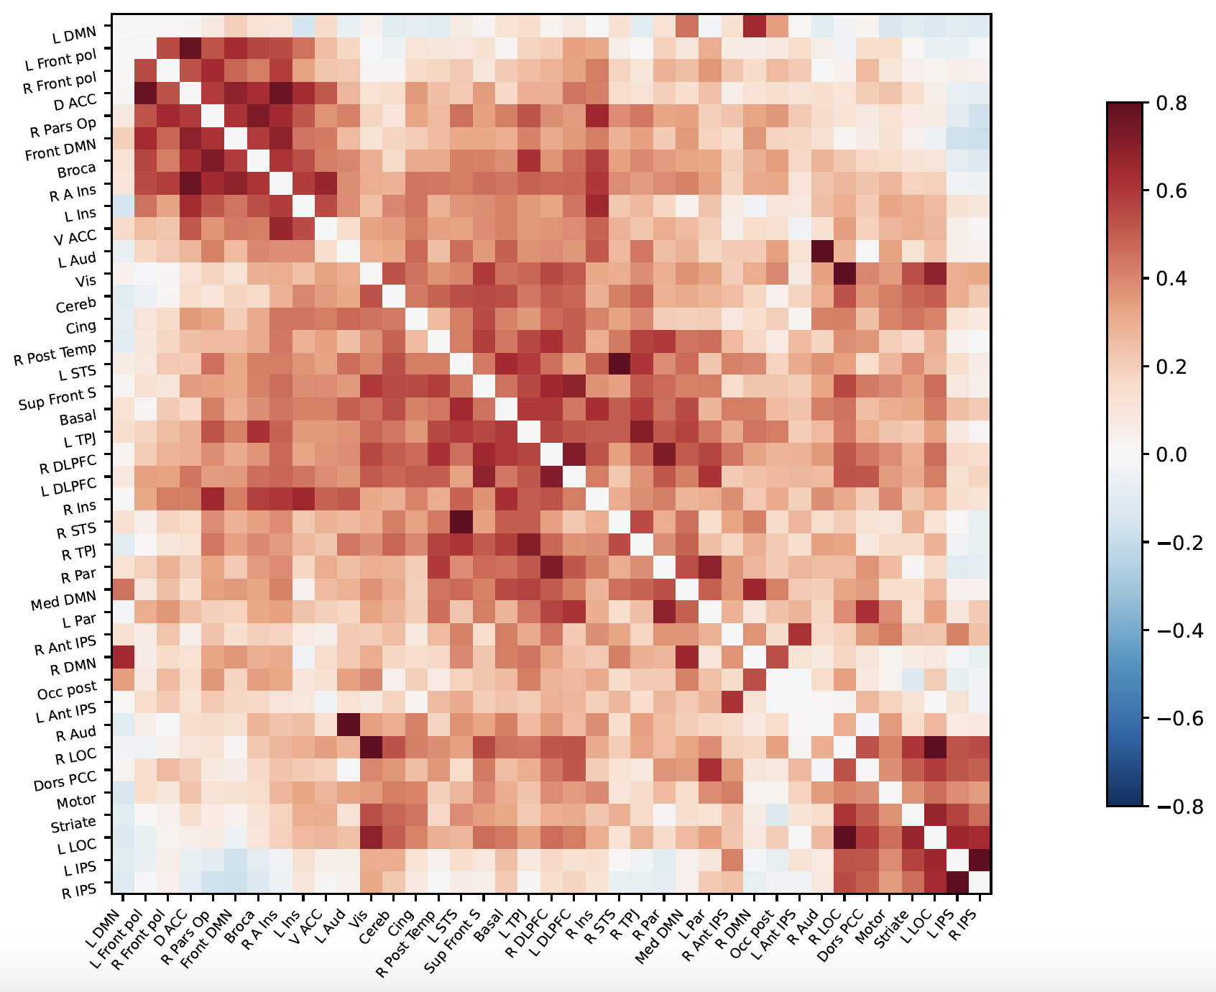
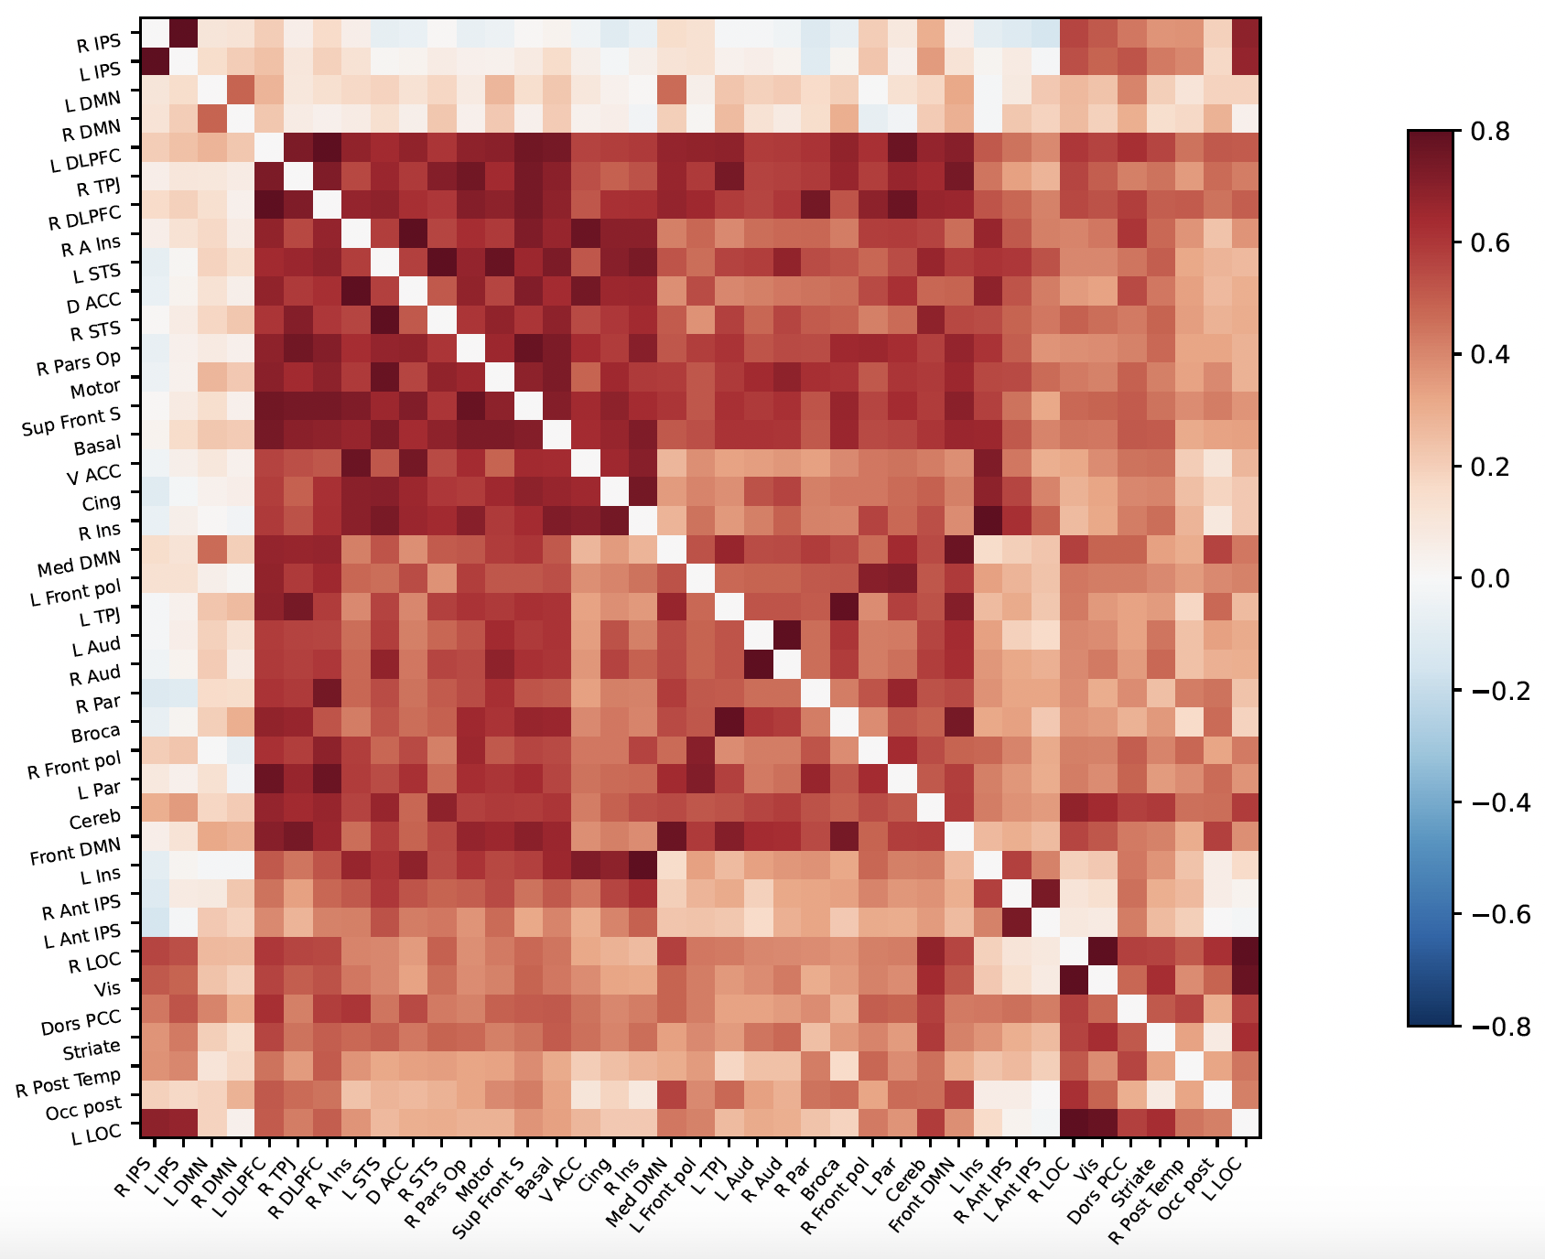
Phase 3: Data visualisation
Single subject correlation matrices - MSDL atlas
Before music therapy
After music therapy

Slide 14
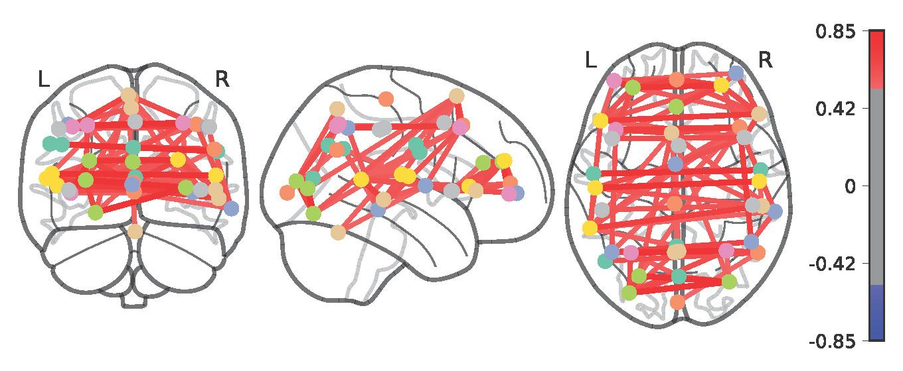
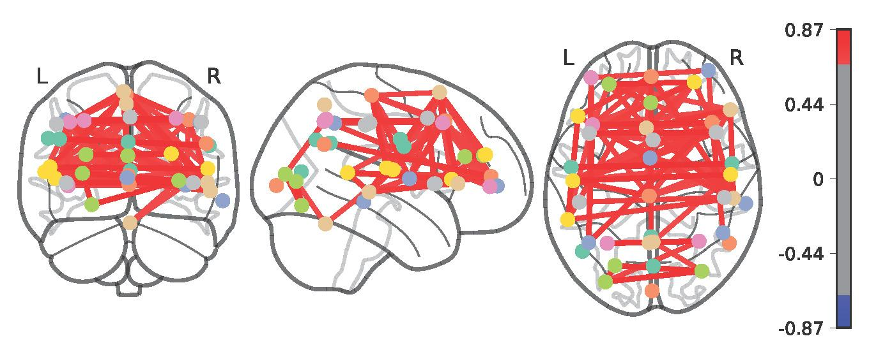
Phase 3: Data visualisation
Single subject connectomes
Before music therapy
After music therapy
More connections around attention control circuits at POST

Slide 15
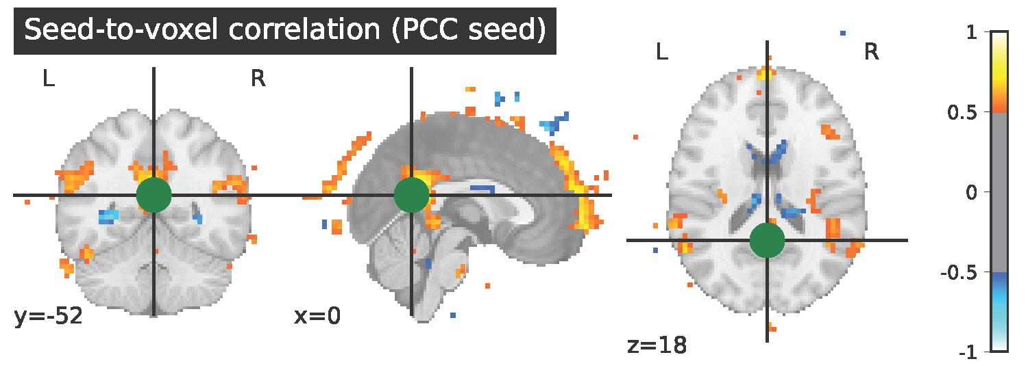
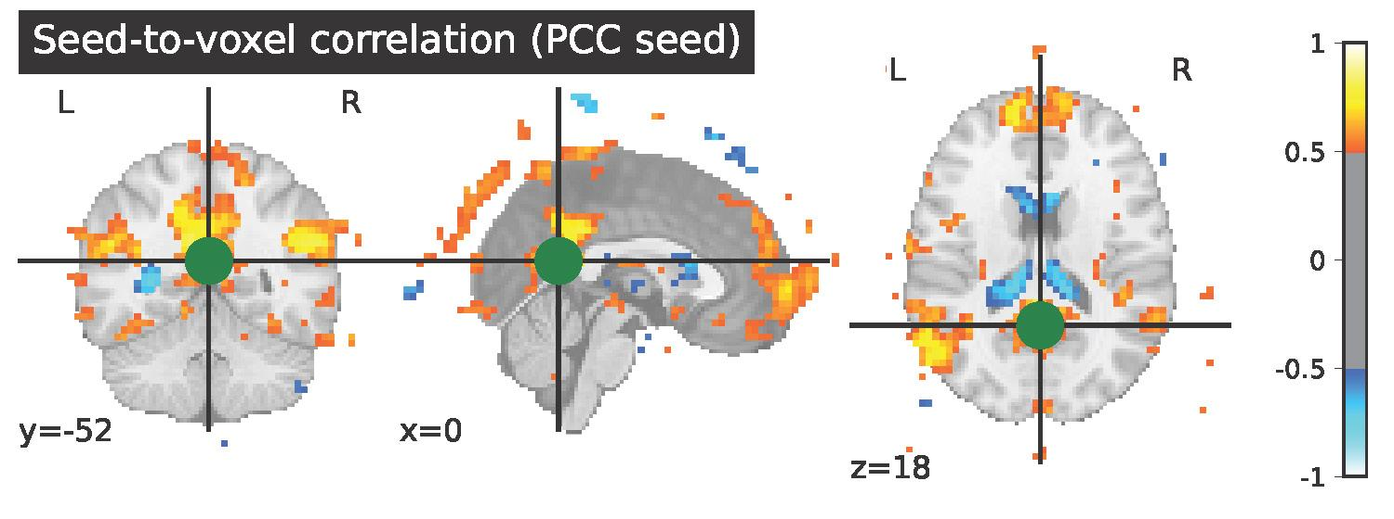
Phase 3: Data visualisation
Single subject seed-based connectivity - MSDL atlas
Posterior Cingulate Cortex seed
Before music therapy
After music therapy
More connections to frontal and visual cortices at POST

Slide 16
Phase 4: Group connectivity
Hope to explore group seed-based connectivity
Compare pre and post visually
Compare to controls
Work out how to run all subjects using Alliance Canada

Slide 17
Outcome/Deliverables
project workflow detailed in my [GitHub repository](https://github.com/brainhack-school2022/jamey_project)
the bash code I used to run BIDS conversion and fMRIprep
a markdown file introducing the project, highlighting the visual results and a discussion with recommendations

Slide 18
THANK YOU ALL
FOR YOUR WONDERFUL HELP

